Slide 1
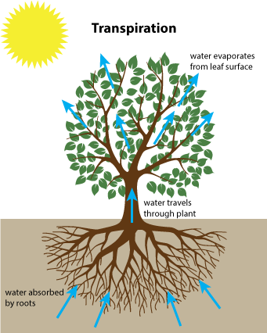
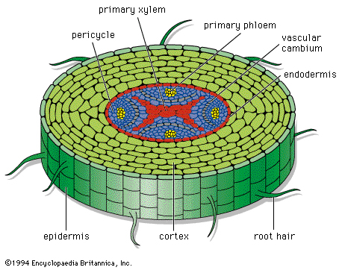
Transport in plants
Why a tree can grow very tall?

Slide 2
contents
Vascular bundle
Distribution of xylem and phloem
Structure of xylem and phloem (adaptations)
How is water obtained and transported by plants (cohesion & adhesion)
Transpiration (potometer)
Translocation

Slide 3
Vascular bundle
A vascular bundle is a part of the transport system in vascular plants.
The transport happens in vascular tissue, which exists in two forms: xylem and phloem.
Both tissues are present in a vascular bundle

Slide 4
Xylem & phloem
features | xylem | phloem
materials transported
cells
cytoplasm
end walls
direction of flow
cell wall thickness
cell wall composition
other worth mention

Slide 5
Features of xylem and phloem
xylem
phloem

Slide 6

Not required
Not required

Slide 7
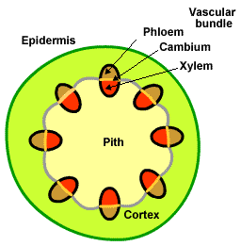
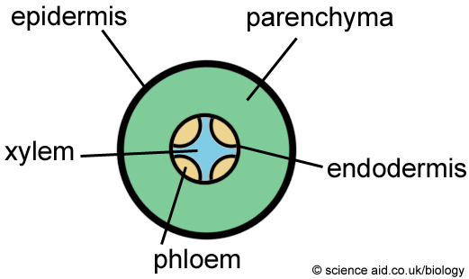
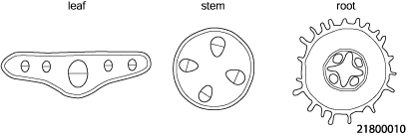
Distribution of xylem and phloem in dicots
Dicot root: at the centre
Dicot stem: arranged in a ring near the outside edge.
X
P60
X – xylem
P - phloem
P

Slide 8
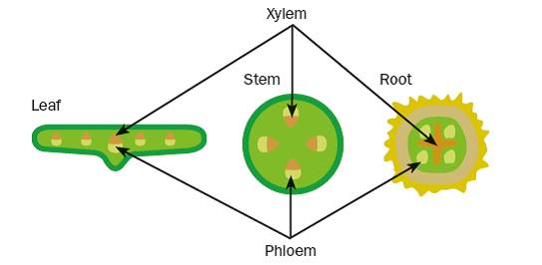
Distribution of xylem and phloem in dicots

Slide 9
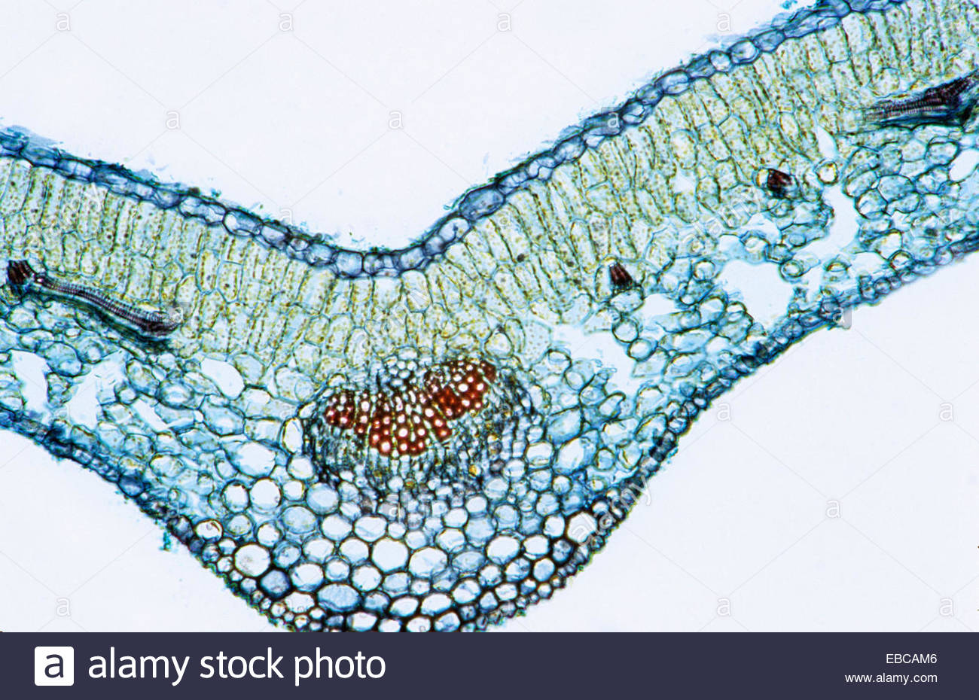
Identify xylem & phloem
Upper epidermis
Palisade mesophyll
Spongy mesophyll
Air space
Lower epidermis
xylem
phloem

Slide 10
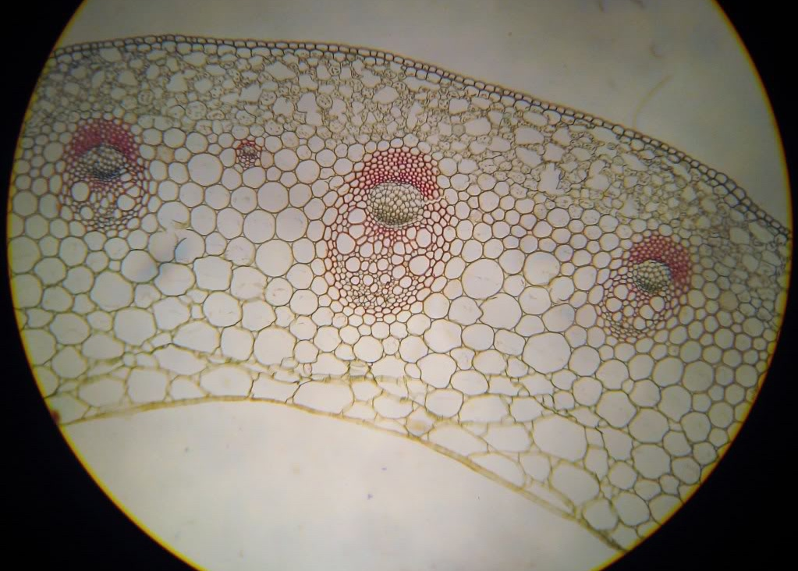
Identify xylem & phloem
P
X
How can you design an experiment to find out the position of xylem in a plant?
Hint: water soluble red pigments.
stem

Slide 11
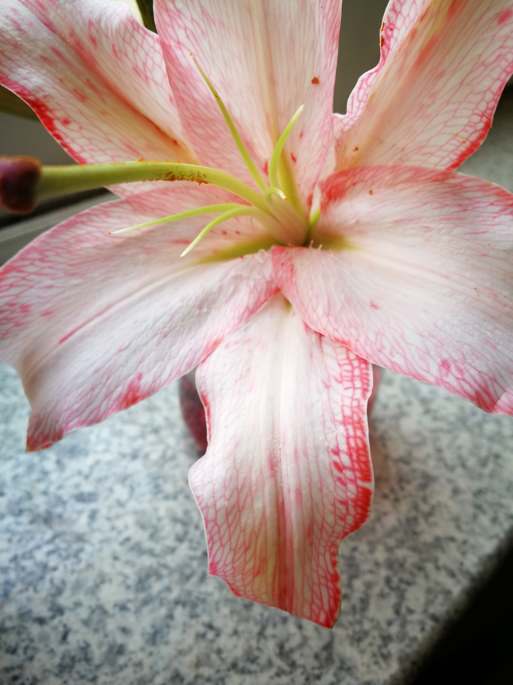
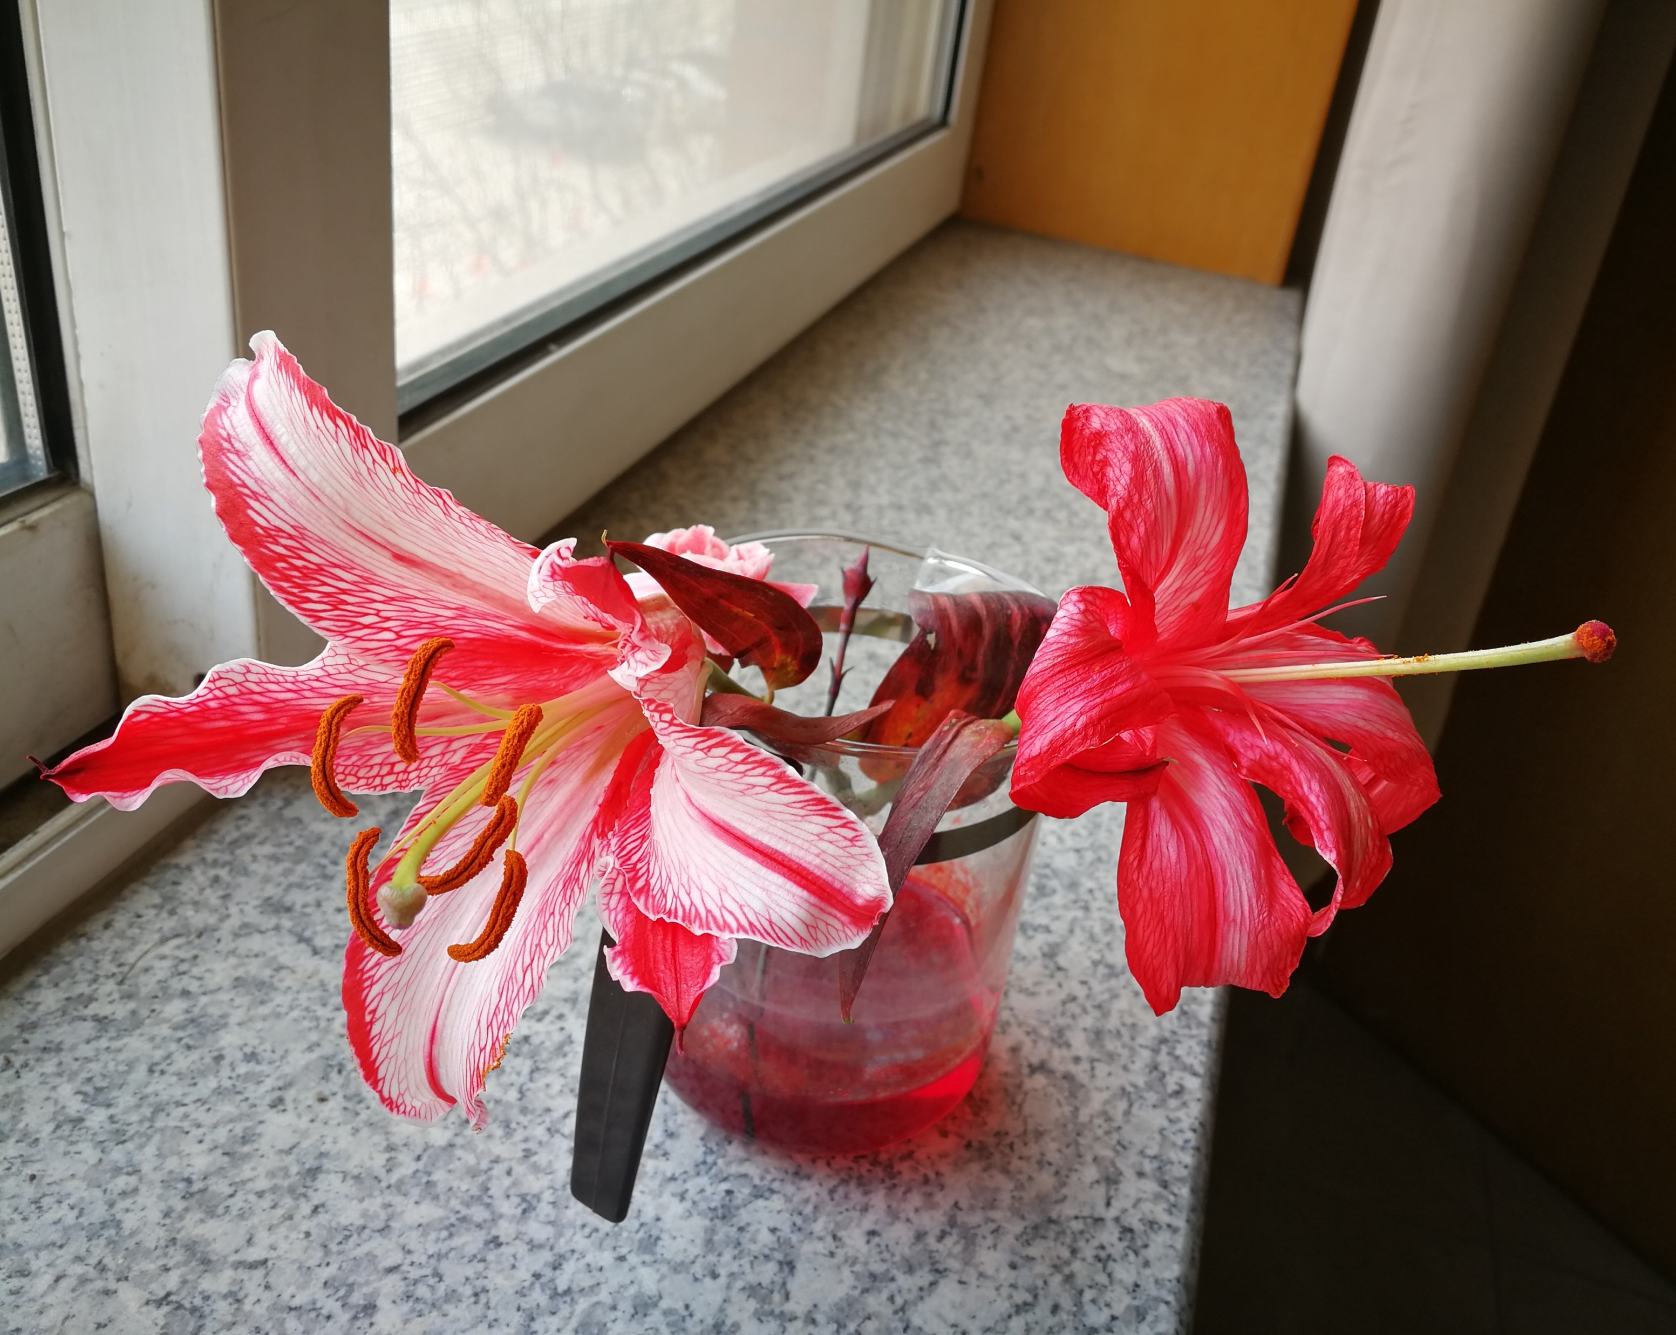
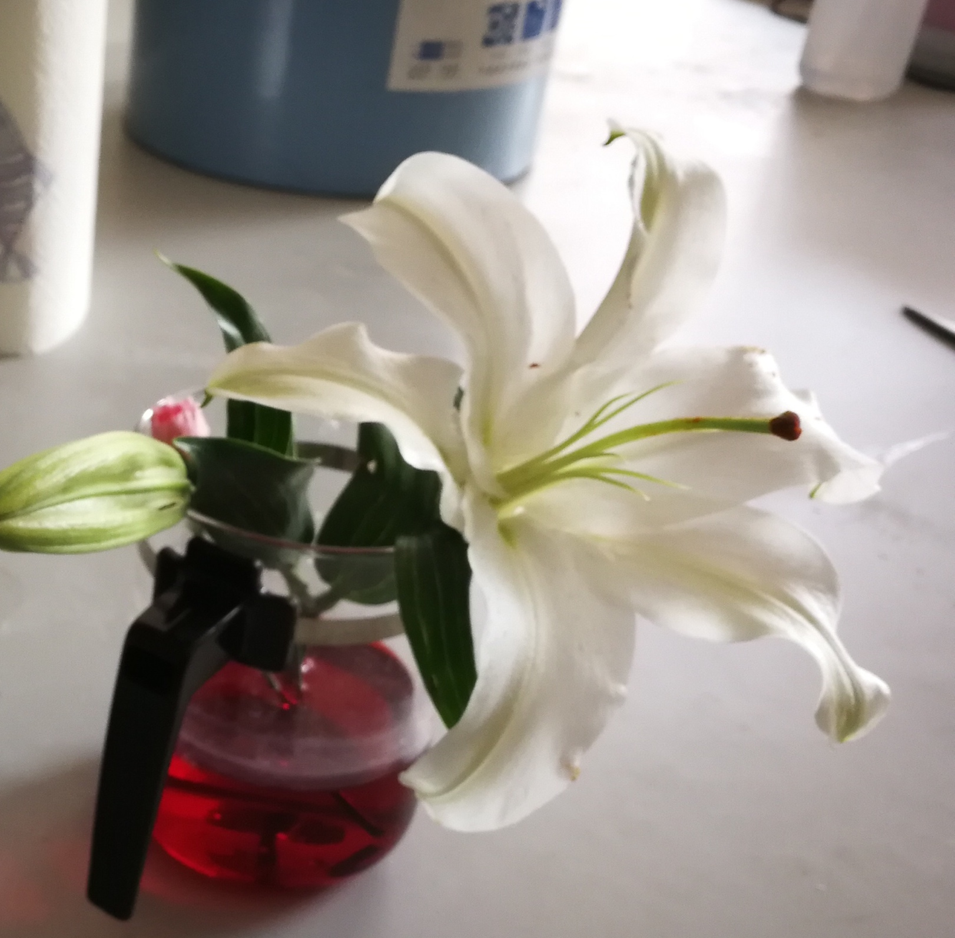
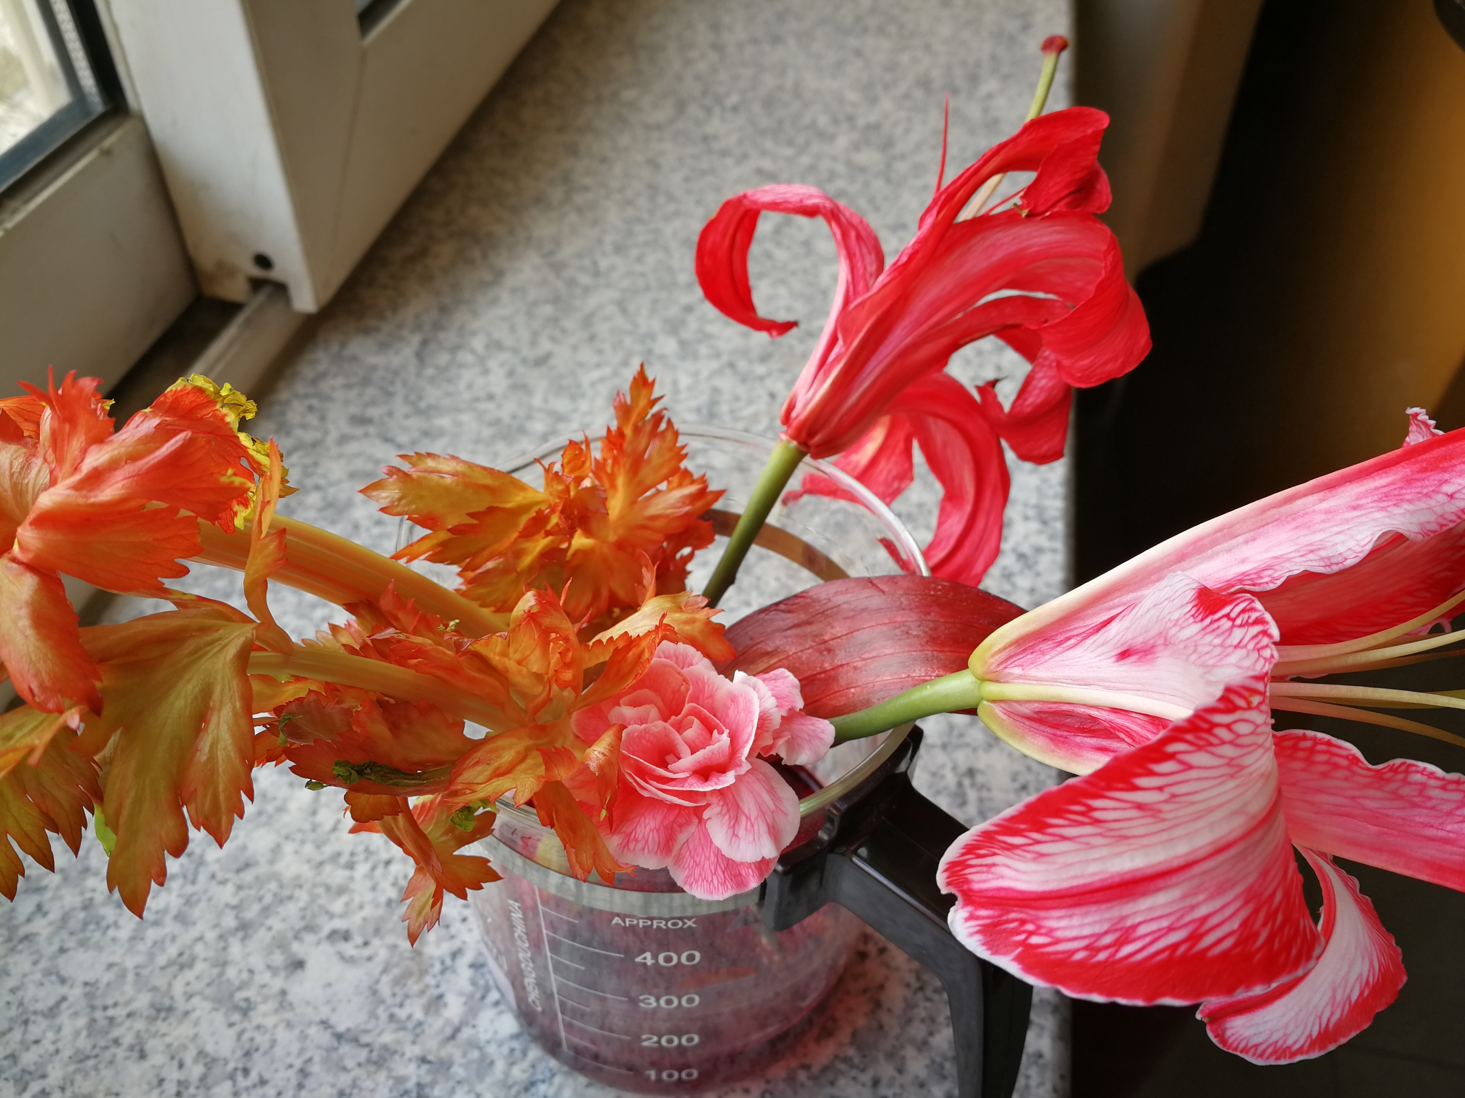
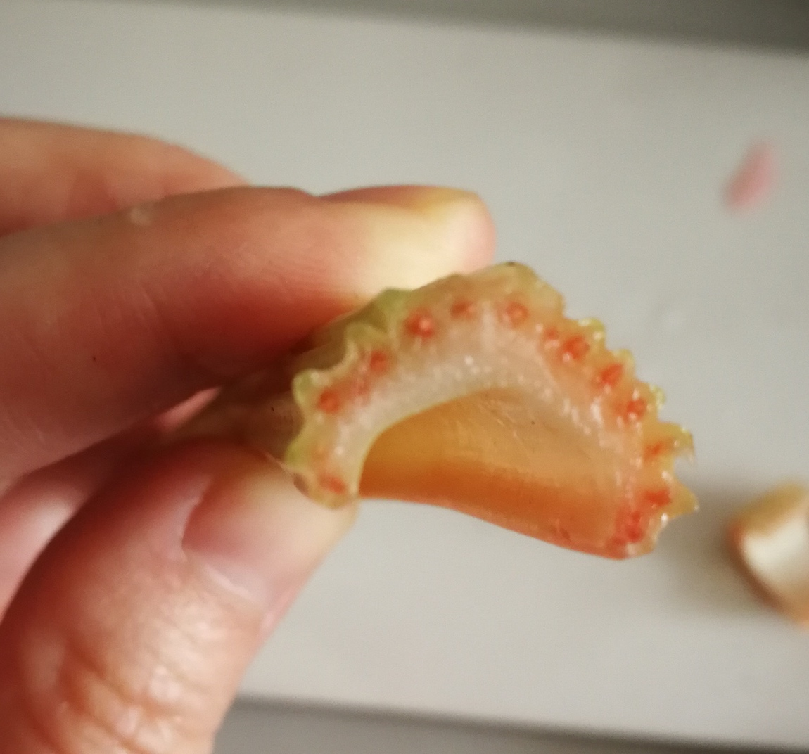

Slide 12
Water uptake in plants

Slide 13
Water uptake in plants
In plants, as long as water move through a partially permeable membrane (net movement), i.e. cell membrane, we consider it as osmosis.
2 (enter root hair cells), 3, 4, 6 (& from inside mesophyll cells to cell wall) are osmosis.
7 (from cell wall to air space) is diffusion

Slide 14
Root structure

Slide 15
Water uptake – from soil to roots

Slide 16
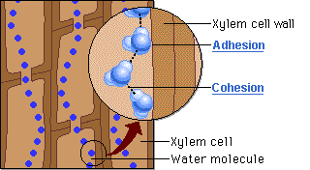
How does water move up xylem?
This movement of water up xylem (mass flow, not diffusion/ osmosis) depends on two properties of water:
Cohesion – the water molecules tend to attract each other and stick together.
Adhesion – the water molecules also tend to stick to the inside surfaces of the xylem vessels.

Slide 17
Water uptake - Transpiration
Definition:
Transpiration is the evaporation of water from the surface of the mesophyll cells followed by loss of water vapour from the plant’s leaves through the stomata.
There is a continuous flow of water from the roots to the leaves (transpiration stream).

Slide 18
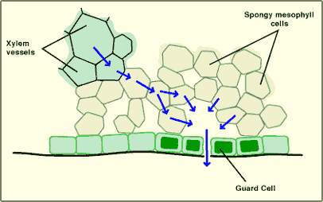
Water loss from leaves
Water passes from the xylem vessels into the mesophyll cells by osmosis.
Water evaporates from the moist cell wall surfaces of the mesophyll cells.
Water vapour diffuses out through the stomata

Slide 19
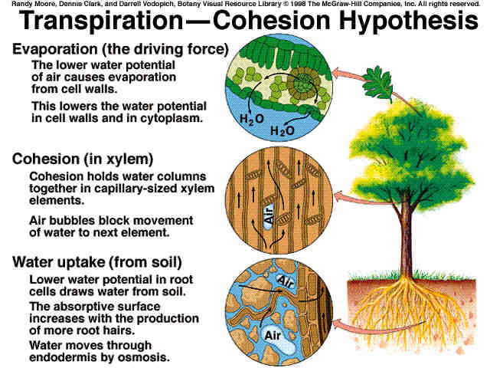
transpiration
& Adhesion

Slide 20
What factors affect transpiration?
There are several environmental factors that can affect the rate of transpiration.
Temperature
Humidity
Light intensity
Wind
Water supply (soil)

Slide 21
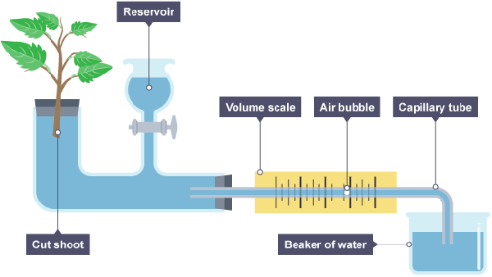
Potometer
What is the role of reservoir here? Does the system work if you remove reservoir?
Key concepts:
Airtight seal (can use petroleum jelly);
(reservoir)
Measure distance air bubble or meniscus moves.

Slide 22
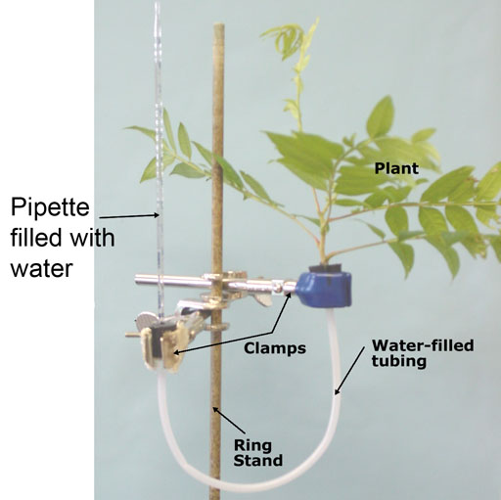
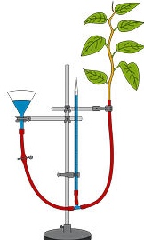
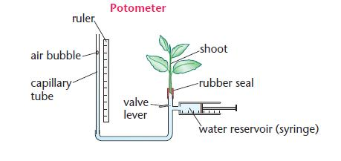
Potometer

Slide 23
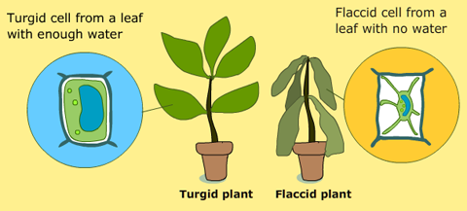
What happens if a plant does not get enough water?
Plants wilt when they lose more water than gain. Plant cells that make up the plant lose water and become floppy, not firmed, or called flaccid.

Slide 24
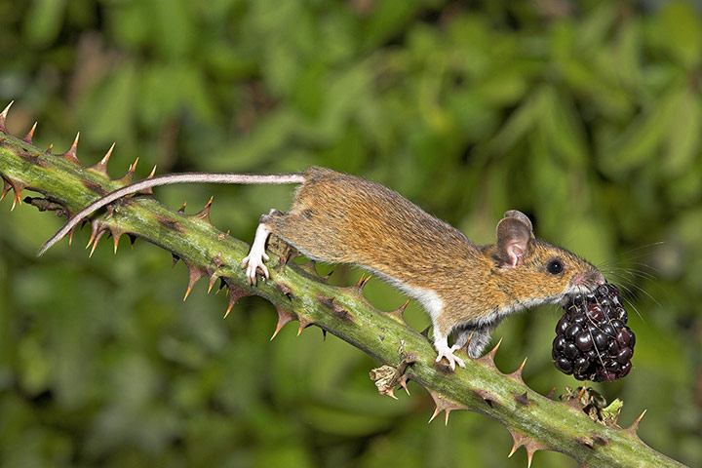
Translocation
Definition:
Translocation is the movement of
sucrose and amino acids in the phloem
from regions of production (source) in the leaves
to regions of storage, or to regions of utilisation in respiration or growth (sink).
Discuss about source and sink in plants.
a. Are leaves or shoots always source?
b. Can storage root (carrot, sweet potato) or stem (potato tuber) be the source?
c. When can a storage root or stem be a source? (hint: different seasons)

Slide 25
Sources and sinks
In plant transport, the part of the plant where a substance begins its journey is called a source.
The part where it ends its journey is a sink.
At different times of the year, a plant organ may be a source or a sink.

Slide 26
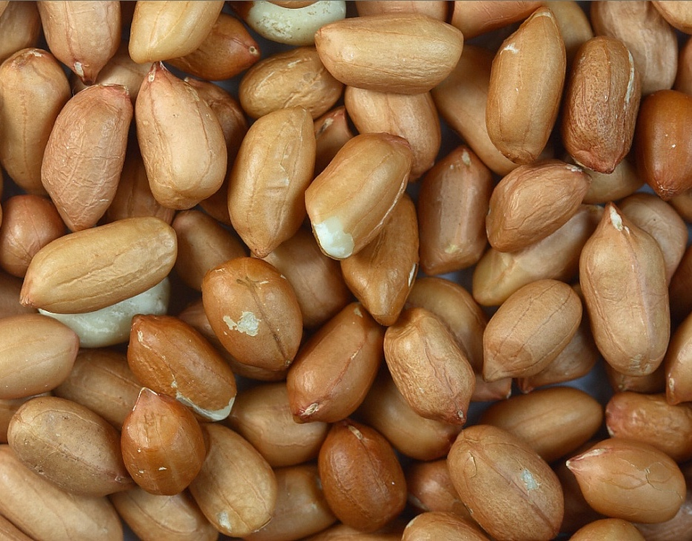
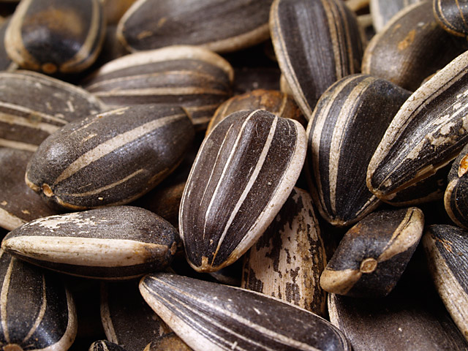
Translocation
Leaves make fatty acids that are stored in many seeds as oils, and are also needed for the waxy cuticle on the upper surface of the leaves.

Slide 27
Transpiration / translocation
 | Substances involved | Active or passive | Tissues involved
Transpiration | Water, mineral ions | Passive (does not require energy) | Xylem (dead cells)
Translocation | Sucrose, amino acids, fatty acids | Active (requires energy) | Phloem (living cells)

Slide 28
Quick-Quiz
1. What is a vascular bundle?
Xylem and phloem, for transport in plants
2. Through which tissue are amino acids transported?
Phloem
3. Give two examples of substances being translocated.
Amino acids, sucrose, hormones
4. What is the movement direction of transpiration?
From root to leaves/ upwards
5. What is the movement direction of translocation?
Both upwards and downwards/ from source to sink
6. What is source & sink?
Site of production/ absorption; site of storage/ utilisation
7. What is the pathway of water in plants (detailed)?
Root hair, root cortex, xylem, mesophyll cells, (cell surface/ membrane), air space, stomata

Slide 29
Quick-Quiz
8. What is cohesion?
Water molecules stick together, due to electrical attraction
9. Where does transpiration start?
Leaves/ stomata/ leaf surface
10. Why wilting occurs?
Water loss more than water uptake
11. Where will become red if you put a stem of in a beaker of red food dye solution?
xylem
12. How much water uptaken by plants is lost by transpiration, generally? (percentage)
About 95%

Slide 30
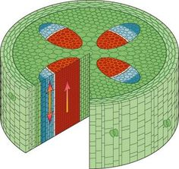
X
P

